Slide 1
Deliverable 4

Slide 2
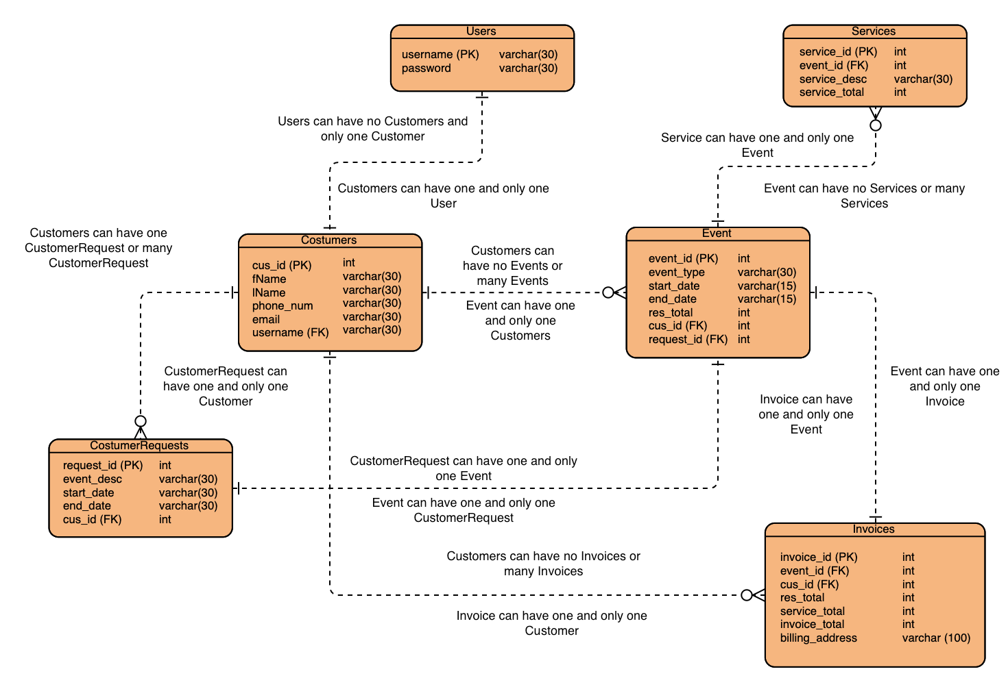

Notes:
Theresa

Slide 3
ER Diagram - Entities and Attributes
Users
Username, password
One user registered as one customer
One customer registered as one user
Customers
Cus_id (pk), fName, lName, phone_num, email, username (fk)
A customer must request one, but can have many, customer requests for event
A customer can have many or no invoices associated with them
A customer can have many or no scheduled events associated with them
Event (create event)
Event_id (pk), event_type, start_date, end_date, res_total, cus_id (fk), request_id (fk)
An event must be associated with one and only one customer
An event must be associated with one and only one customer request
An event can have many or no services rendered to it.
An event must be associated with one and only one invoice
Invoice (create invoice)
Invoice_id (pk), event_id(fk), cus_id (fk), res_total, service_total, invoice_total, billing address
An invoice can belong to one and only one event.
An invoice can belong to one and only one customer
Services
Service_id (pk), event_id (fk), service_desc, service_total
Service rendered must belong to one and only one event.

Slide 4
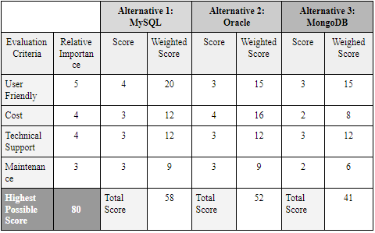
Team Matrix
Notes:
Courtney

Slide 5
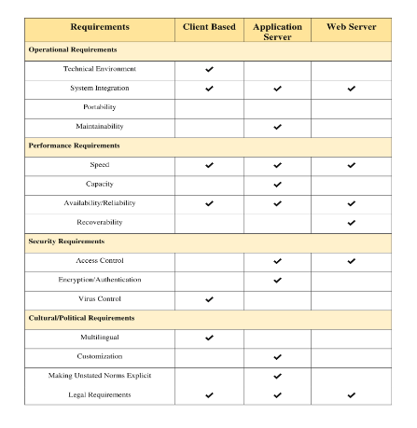
Decision Matrix
Notes:
Courtney

Slide 6
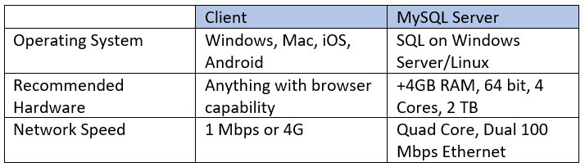
Hardware and Software Specifications
Notes:
Sara

Slide 7
Deliverable 5

Slide 8
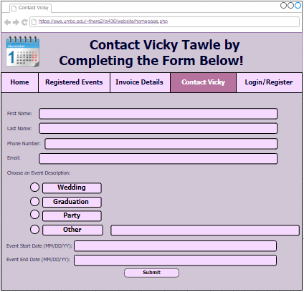
User Interface Design
Contact Prototype
Notes:
Courtney

Slide 9
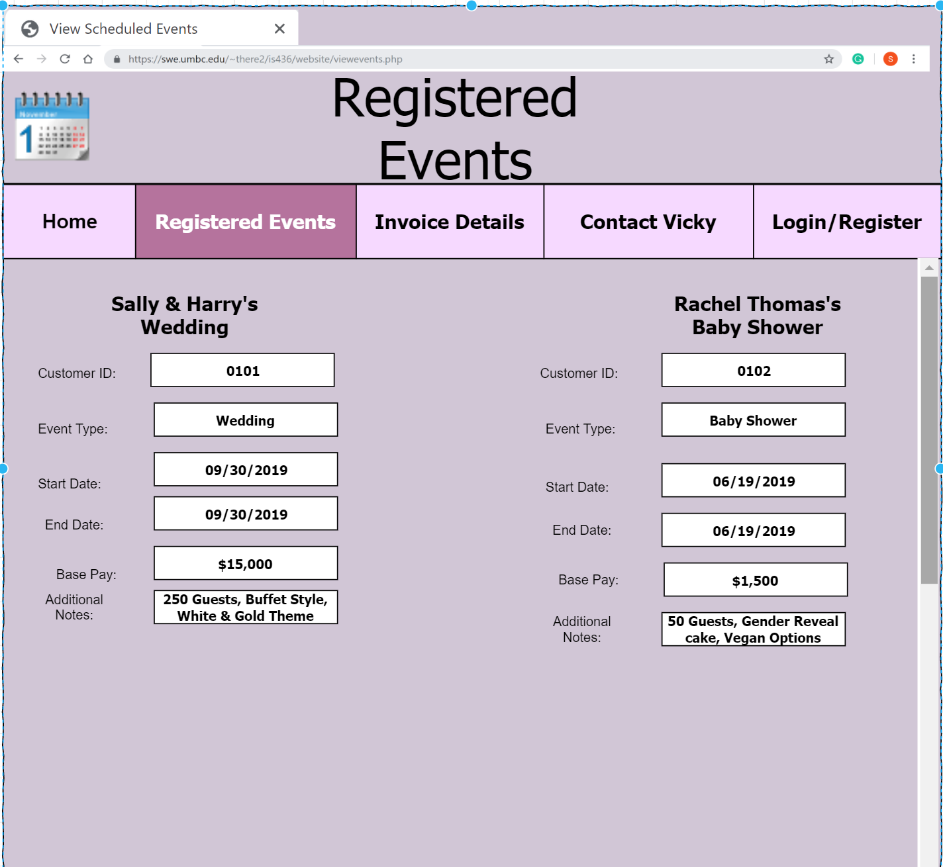
Registered Events Prototype
Notes:
Sara

Slide 10
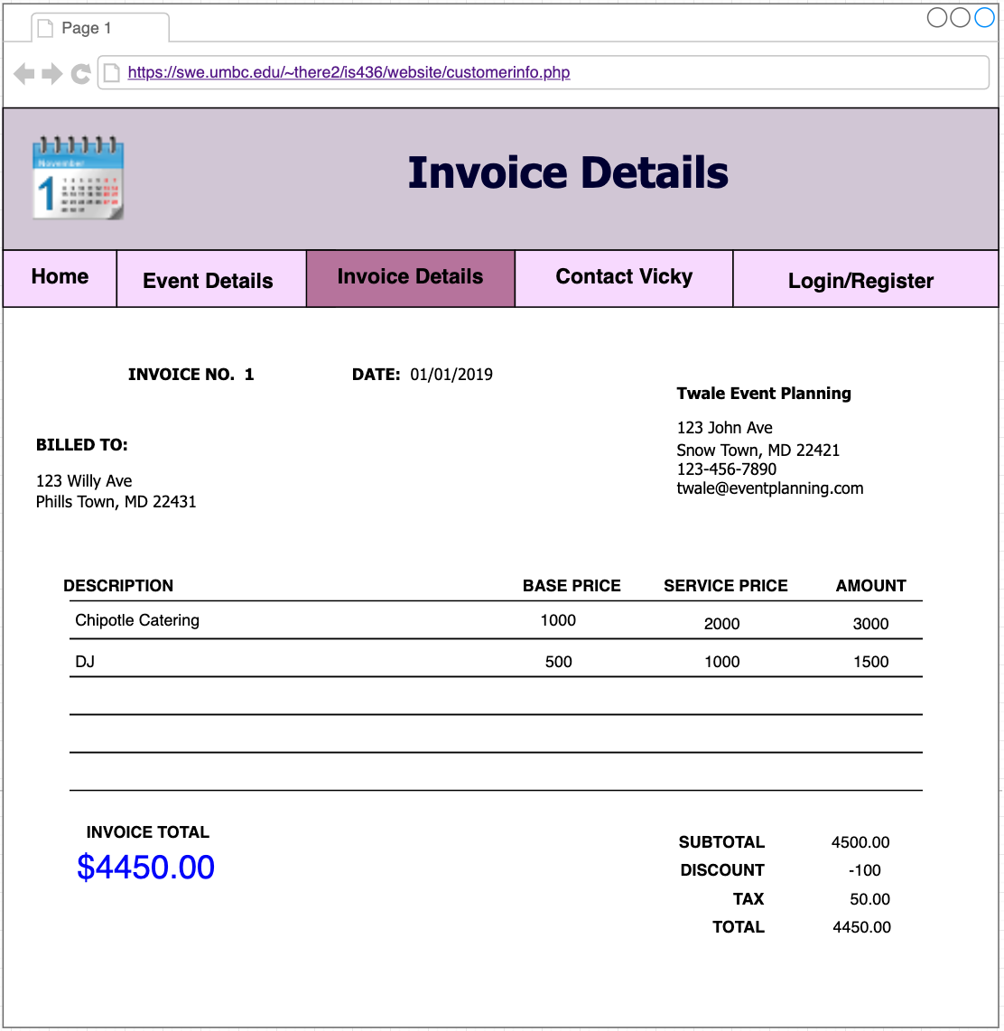
Invoice Details Prototype
Notes:
Krishna

Slide 11
Interface Standards
Common elements across individual screens, forms, and reports
Color theme and format
Interface Metaphors
Calendar
Interface Objects
admin/owner and employees
Interface Actions
login, register, view customer requests, schedule events, view and edit scheduled events, view and edit current customer information, and view and edit invoice details.
Interface template
Consistent layout
Notes:
Mehak

Slide 12
System Implementation
System Requirements:
Software:
phpMyAdmin, Web browser, DBMS
Hardware:
Any hardware with browser capability
Platform:
HTML, PHP, CSS, OS
Notes:
Theresa

Slide 13
Team Experience with SDLC
Stages of SDLC
Planning:
All members agreed upon web application development for an event planning business.
Analysis, Design, and Implementation:
Concrete project plan allowed these to be completed with ease.
Challenges
Creating functional web application using relational databases.
Rewarding Aspects
Visually seeing the final web application.
Notes:
Sar

Slide 14
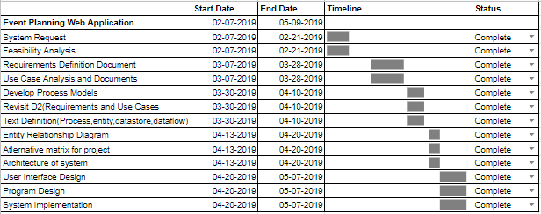
Updated Project Plan
Notes:
Mehak

Slide 15
Kanban Flow
Deliverable 4
https://kanbanflow.com/board/61x4Yk
Deliverable 5
https://kanbanflow.com/board/M7HPnG
Notes:
Krishna

Slide 16

Demo
Login: https://swe.umbc.edu/~there2/is436/website/login.php
Registration: https://swe.umbc.edu/~there2/is436/website/reg.html
Notes:
Theresa

